Slide 1





JavaScript Applications
Course Overview
Apps
JavaScript Applications
SoftUni Team
Technical Trainers
Software University
http://softuni.bg

Slide 2


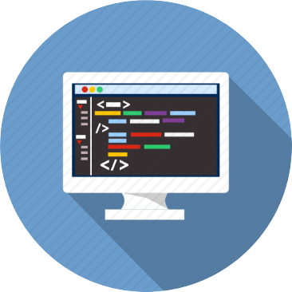
Table of Contents
Course Objectives
Course Program
Trainers Team
Course Schedule
Exams and Evaluation
Learning Resources

Slide 3
Have a Question?
sli.do #JSCORE

Slide 4






SoftUni Diamond Partners

Slide 5






SoftUni Diamond Partners

Slide 6
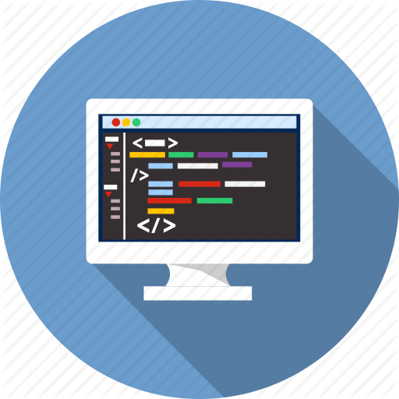
JavaScript Applications
Apps
Course Objectives & Program

Slide 7

Course Objectives
The JavaScript Applications course provides
Technologies for creating Single Page Apps (SPA)
Consuming RESTful Services (REST) with AJAX
Creating UI templates
Common JS programming patterns and routing

Slide 8
Course Topics
HTTP, REST Services, Postman
AJAX and jQuery AJAX
Asynchronous programming and promises
Creating single-page app with jQuery, AJAX, REST and Firebase
Templating: creating UI with Handlebars
Routing with Sammy.js
JS tools and libraries

Slide 9

The Trainers Team

Slide 10

Trainers Team
Nikola Andreev
Web Developer
Passionate about Java and JavaScript
Experienced technical trainer
Top performing student from SotfUni

Slide 11
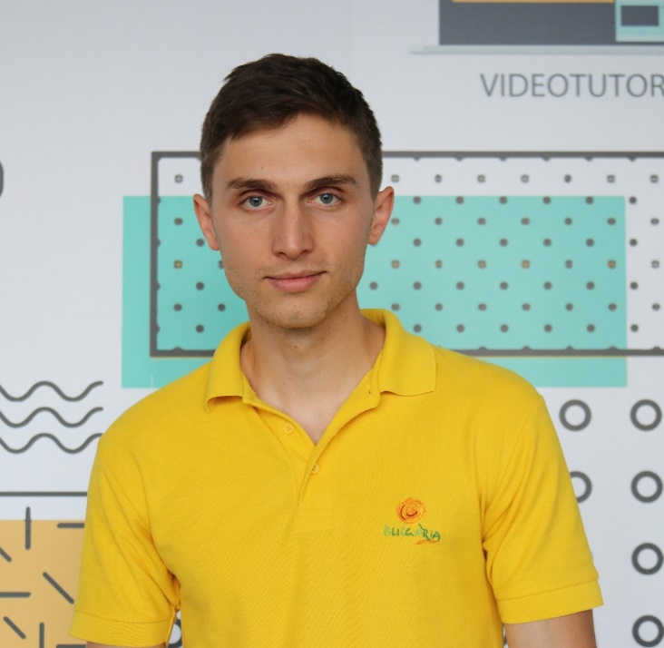
Trainers Team
Ivaylo Dimitrov
4+ years experience in the IT (HTML, CSS, JavaScript, C#, SQL,
Windows Server)
Student with excellent grades in Software University
Technical Trainer in Software University

Slide 12

Duration and Evaluation

Slide 13

Training Duration
Lessons: ~ 15-20 hours (onsite + YouTube videos)
Practical exercises (in class): ~ 30-40 hours
Homework: ~ 0-40 hours
Time frame
Jul – Aug 2018
Exam: 12-Aug-2018

Slide 14


Scoring System for the Course
Exam – 90%
Homework (exercises) – 10%
Bonuses: up to 10%
Presence in class: 5% (onsite students only)
Forum activities: 5%

Slide 15

The Final Exam
Create a SPA (single page app)
Implement CRUD operations + login / register / logout
Use AJAX and REST + cloud-based back-end (Kinvey)
Optionally:
Use templates for rendering
Use MVC architecture + routing
AJAX
REST
Kinvey

Slide 16



Learn to Search Online
The course assignments require searching online
This is an important part of the learning process
Some exercises intentionally have no hints
Learn to find solutions!
Software development includes everyday searching and learning
No excuses, just learn to study!
Developers learn new technologies, tools, languages every day!

Slide 17

Homework Assignments
Doing your homework is very important!
Programming can only be learned through a lot of practice!
You should write code every day!
Each lesson is followed by many exercises
Try to solve them in class
The rest are your homework
Homework assignments are due 7 days after each lecture
Submission through the course page

Slide 18










Resources
What We Need Additionally?

Slide 19

The Programming Basics Slides and Videos
All lecture slides, videos, homework assignments, projects and other resources are open content, available for free
Visit the course web site to access the course resources

Slide 20



Recommended Software
Software needed for this course:
Noje.js – https://nodejs.org
WebStorm – https://jetbrains.com/webstorm/
Optionally:
Visual Studio Code – https://code.visualstudio.com

Slide 21







Course Introduction
https://softuni.bg/courses/

Slide 22

License
This course (slides, examples, demos, videos, homework, etc.) is licensed under the "Creative Commons Attribution-NonCommercial-ShareAlike 4.0 International" license

Slide 23





Trainings @ Software University (SoftUni)
Software University – High-Quality Education, Profession and Job for Software Developers
softuni.bg
Software University Foundation
http://softuni.foundation/
Software University @ Facebook
facebook.com/SoftwareUniversity
Software University Forums
forum.softuni.bg

